Slide 1
Digestion

Slide 2
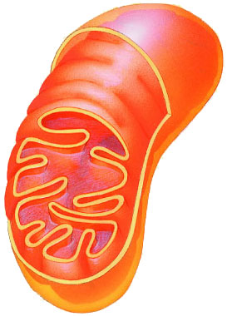
What do animals need to live?
Animals make energy
using:
  food
  oxygen
Animals build bodies
using:
  food for raw materials
    amino acids, sugars,
    fats, nucleotides
  ATP energy for synthesis
food
ATP
O₂

Slide 3
Why We Eat
A balanced diet supplies three needs:
  Energy source – chemical energy for the cellular work of the body
  Nutrients - raw materials to utilize in biosynthesis – we make many of our own molecules
  Essential nutrients – molecules we cannot make and must ingest in created form

Slide 4
Why do we digest food?
To get our cells the nutrients they need.

Slide 5
Digestion Animation
Digestion

Slide 6
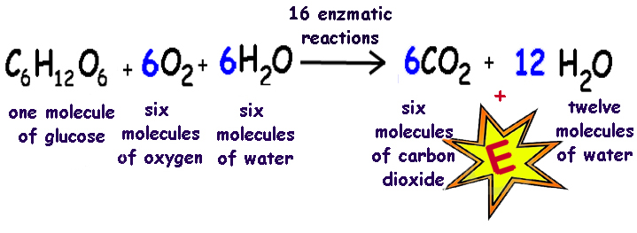
Food as an Energy Source
We obtain energy to power our cells by breaking down complex organic molecules
  What is this process called?
    Cellular respiration
  What is the chemical formula?

Slide 7
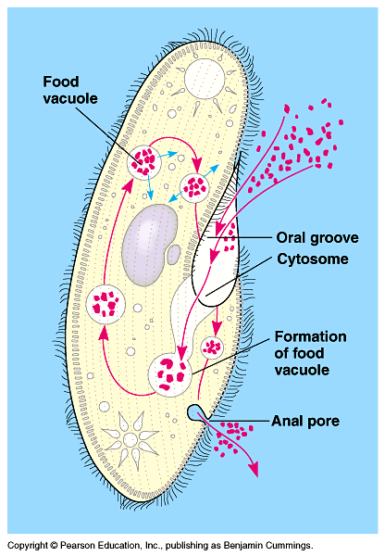
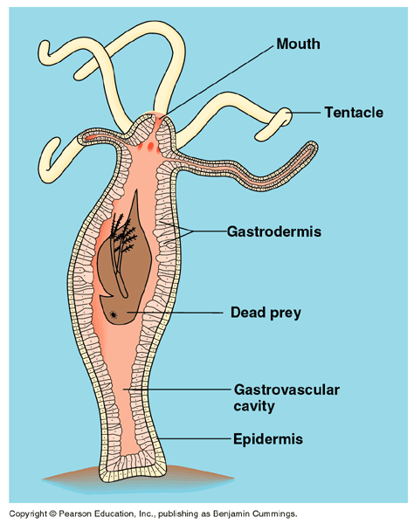
Getting & Using Food
Ingest
  taking in food
Digest
  mechanical digestion
    breaking up food into smaller pieces
  chemical digestion
    breaking down food into molecules small enough to be absorbed into cells
    enzymes (hydrolysis)
Absorb
  absorb across cell membrane
    diffusion
    active transport
Eliminate
  undigested extracellular material passes out of digestive system
intracellular
digestion
extracellular
digestion

Slide 8
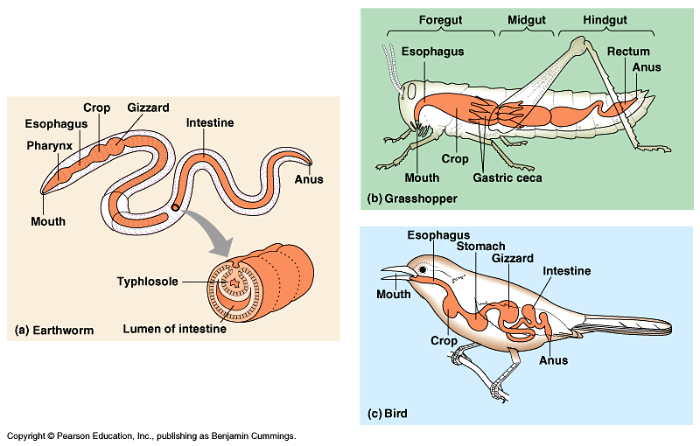
Digestive systems
Everybody’s got one!

Slide 9
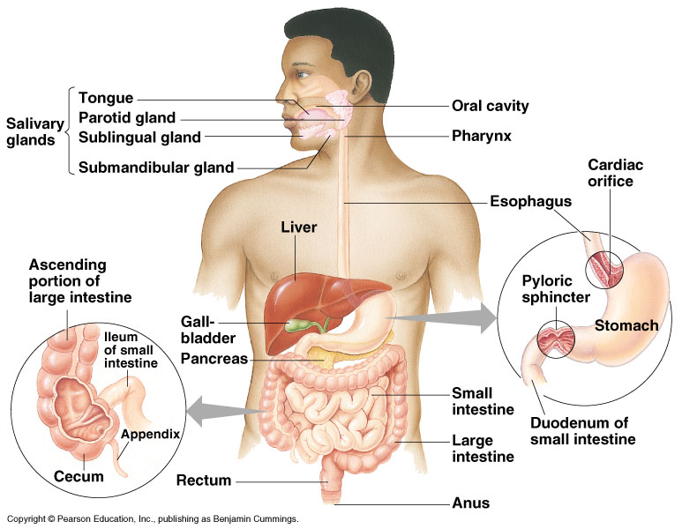
Human digestive system
Alimentary Canal
Notes:
After chewing and swallowing, it takes 5 to 10 seconds for food to pass down the esophagus to the stomach, where it spends 2 to 6 hours being partially digested.
Final digestion and nutrient absorption occur in the small intestine over a period of 5 to 6 hours.
In 12 to 24 hours, any undigested material passes through the large intestine, and feces are expelled through the anus.

Slide 10
Problems with Molecular Size
Most foods we eat are made up of molecules too large to pass across our cell membranes.
Molecules must be small enough to pass from the intestines and into the blood vessels.
Food must be chemically digested to a small size that is able to pass through the cell membranes.

